Slide 1
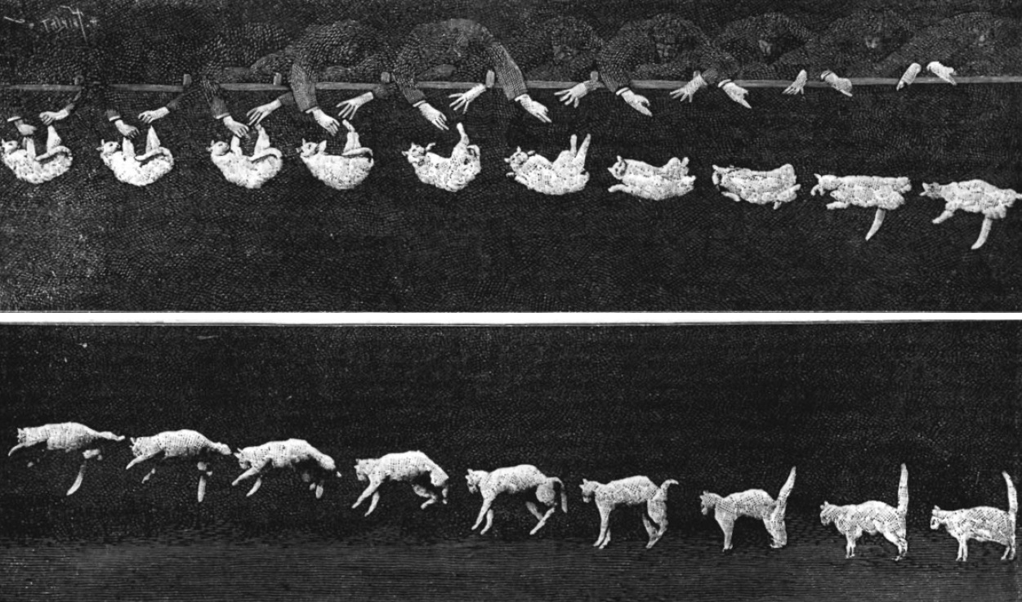




Etienne-Jules Marey 1894
Why cats are easier to invert than geophysics
Leo Portes^{1,3}, Mark Jessell^{1,2,3}, Mark Lindsay^{3,4}, Guillaume Pirot^{1,2,3}, Michel Nzikou^{1,2}, Ed Cripps^{1,3}
¹UWA, ²MinEx CRC, ³ITTC DARE, ⁴CSIRO

Slide 2
Karpatne et al. (2017) summarise the principal challenges to applying Machine Learning to the geosciences:
Spatio-temporal structure
High dimensionality
Paucity of ground truth
Objects with amorphous boundaries
Heterogeneity in space and time
Interest in rare phenomena
Multi-resolution data
Noise, incompleteness and uncertainty in data
Karpatne et al. (2017) Machine Learning for the Geosciences: Challenges and Opportunities. IEEE Transactions on Knowledge and Data Engineering 10.1109/TKDE.2018.2861006

Slide 3
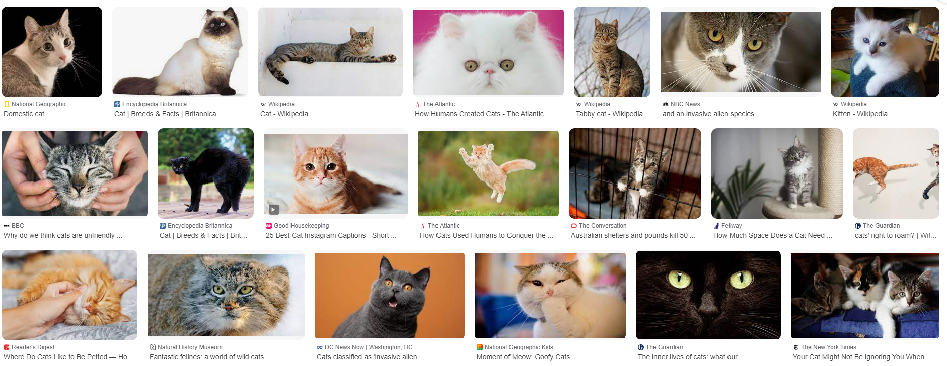

As reported by CNN*, there are estimated to be 6 Billion images of cats indexed by Google
*reliable source

Slide 4
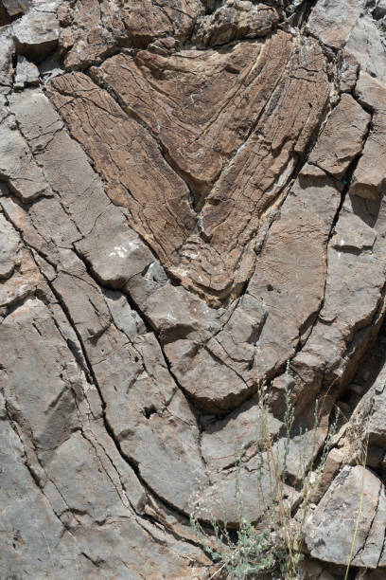
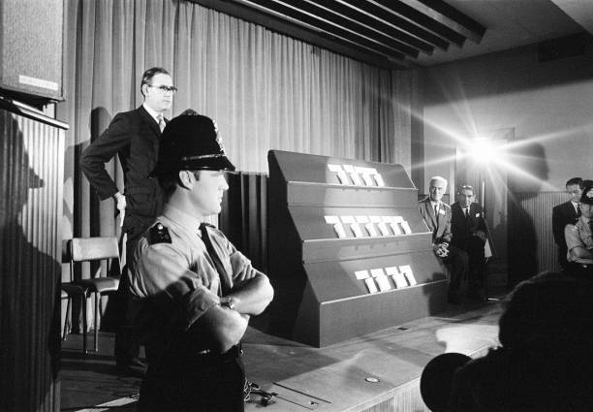

Google Image search has ~700 images of “geological folds”

Slide 5
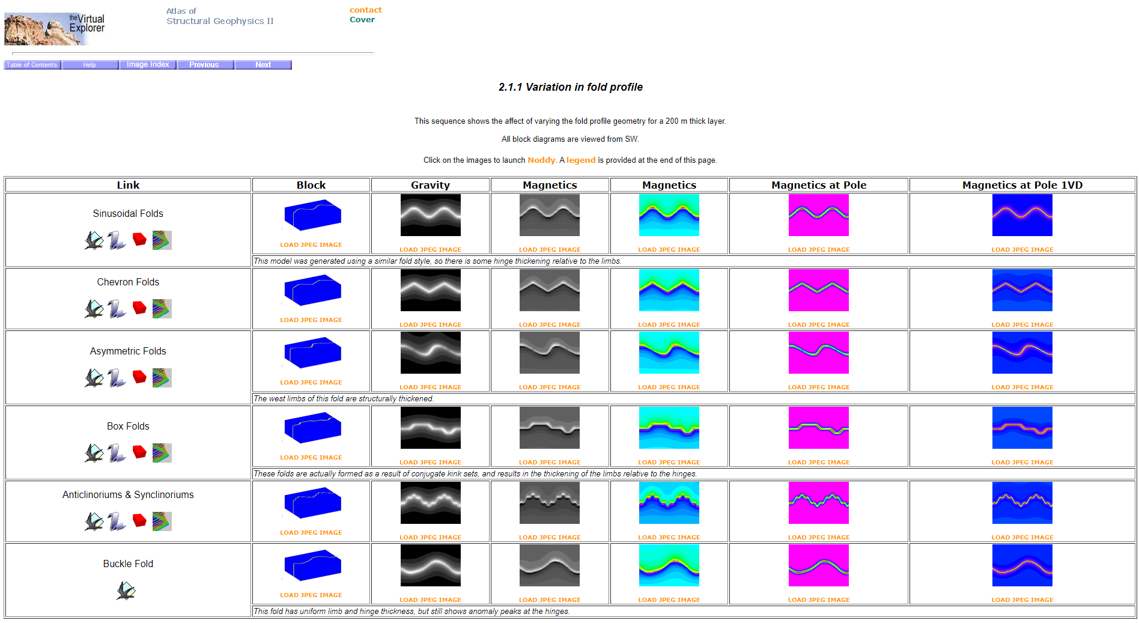
Google has 0 images of “geological folds in magnetic data”
tectonique.net/asg

Slide 6
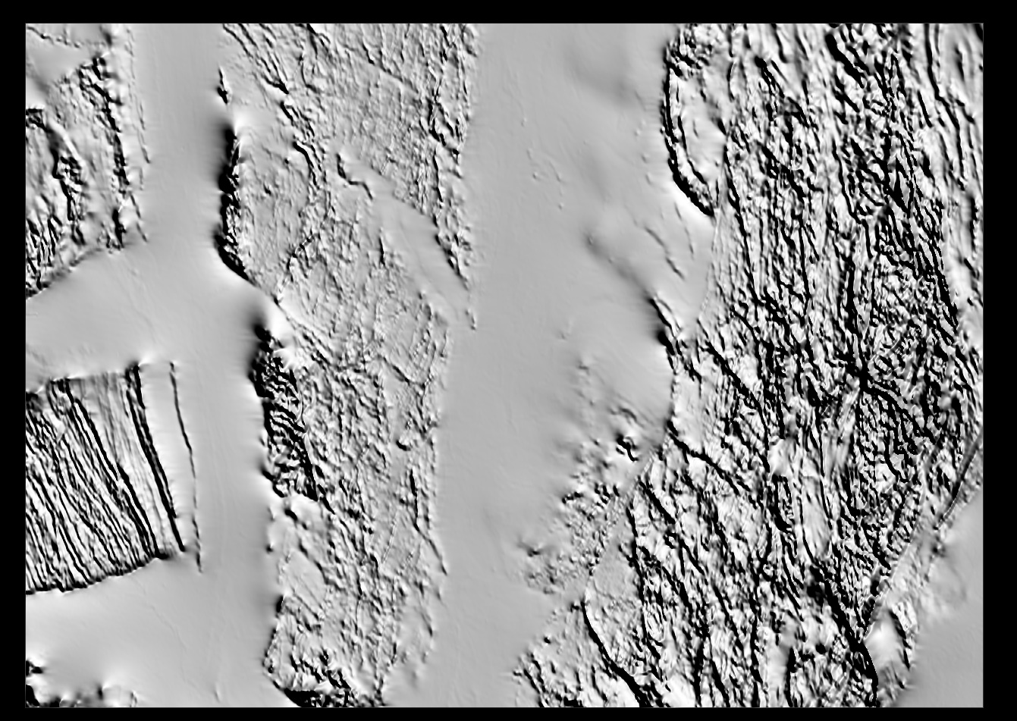
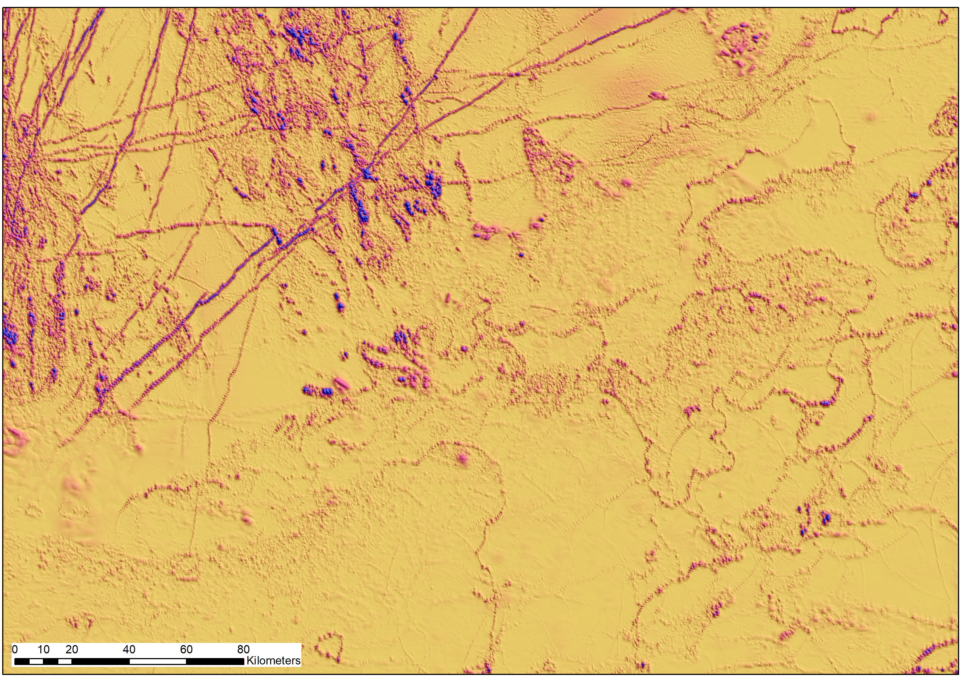
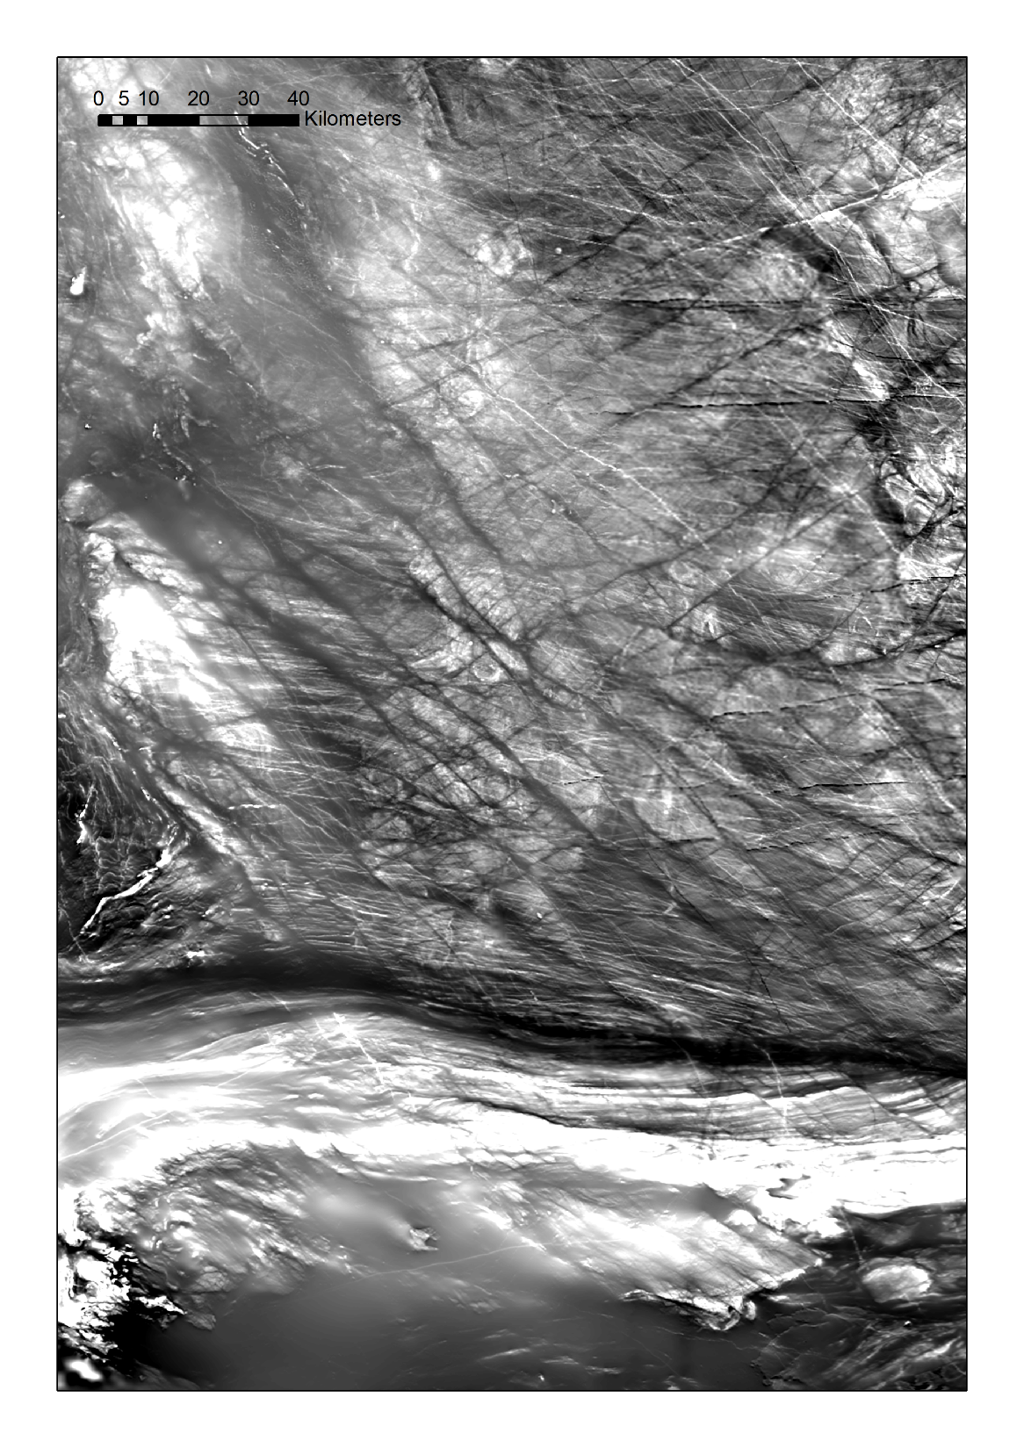
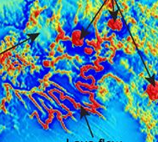
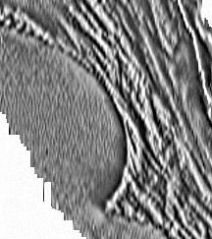
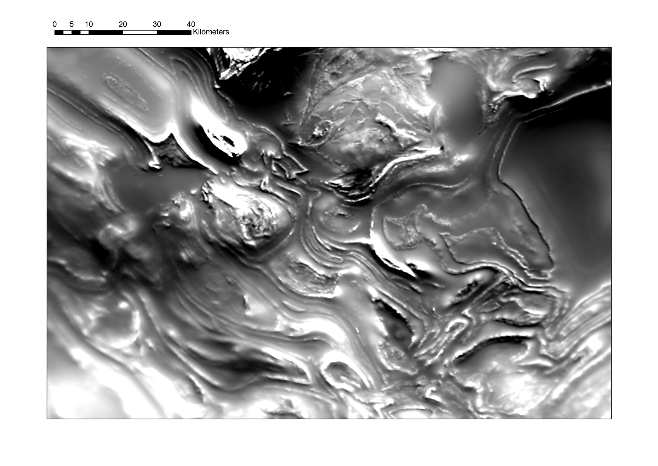
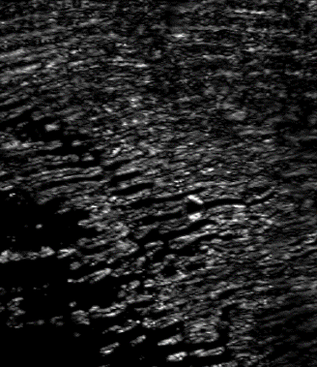
Single or multiple linear features
Stratigraphy
Sills
Dykes
Faults
Lava Flows
Pluton margins
Folds
Paleochannels
Sand Dunes

Slide 7
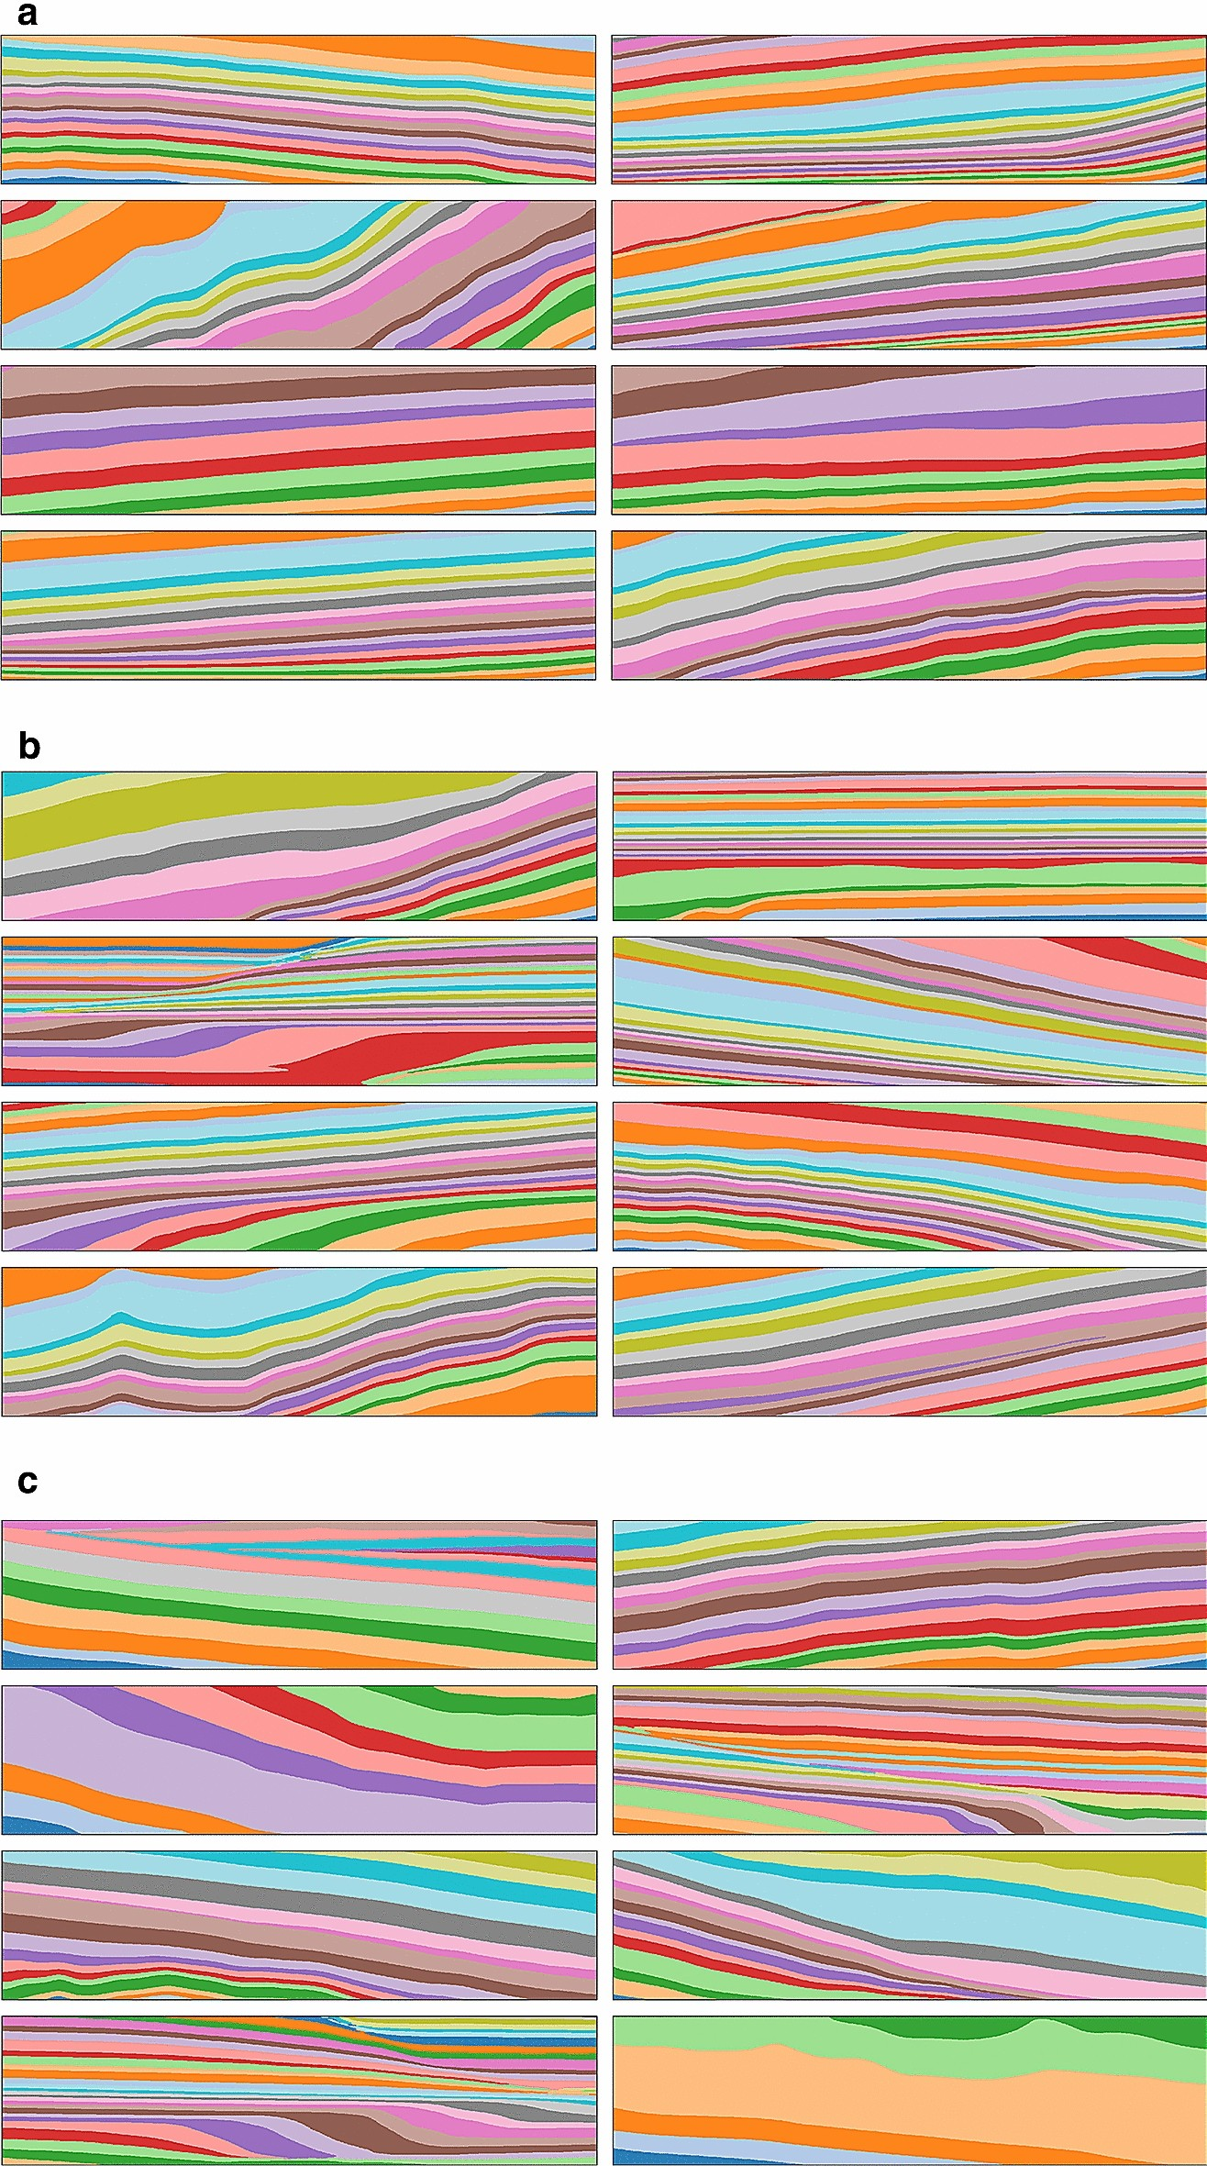
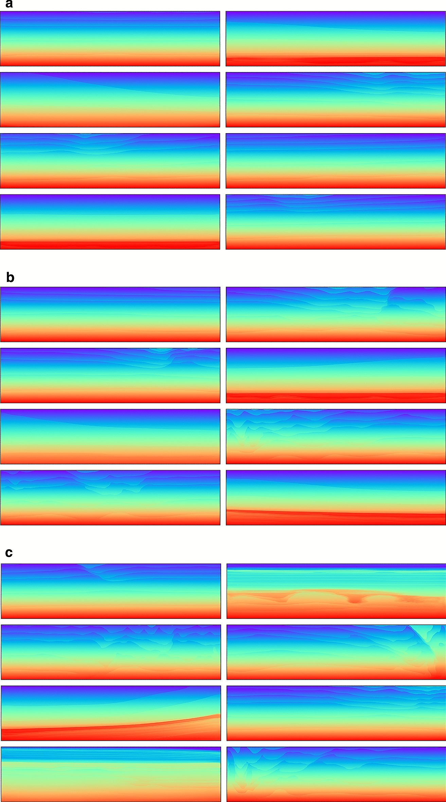
ClinoformNet-1.0: stratigraphic forward modeling and deep learning for seismic clinoform delineation
Hui Gao et al., Geoscientific Model Development, 2022-245
Geophysical model generation with generative adversarial networks
Puzyrev et al., Geoscience Letters 32 2022

Slide 8

Another Solution for more complex 3D geology?
We are using Noddy to generate massive > 1M training sets for 3D geology and resulting gravity and magnetic datasets as inputs to ML systems and as tests of geophysical inversion schemes
Spatio-temporal structure
High dimensionality
Paucity of ground truth

Slide 9

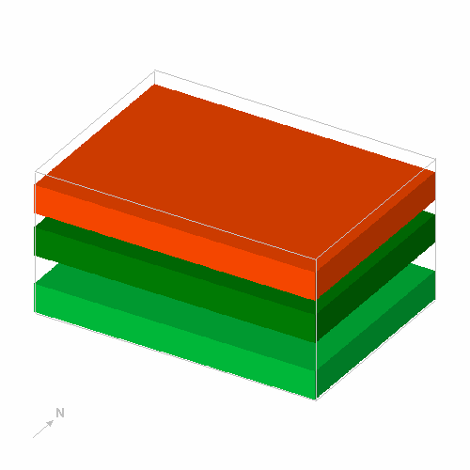
Noddy
Semantic/kinematic/implicit modelling engine
Calculates 3D models based on an idealised description of the kinematics of a sequence of geological events
Density, magnetic susceptibility ( K_{ij} ) and remanence properties assigned to each unit so we can calculate gravity and magnetic responses
Jessell, 1981

Slide 10
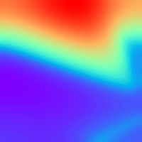

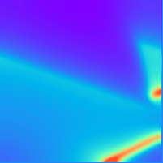
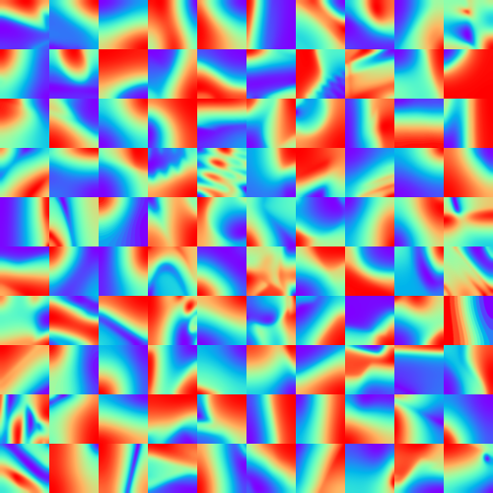
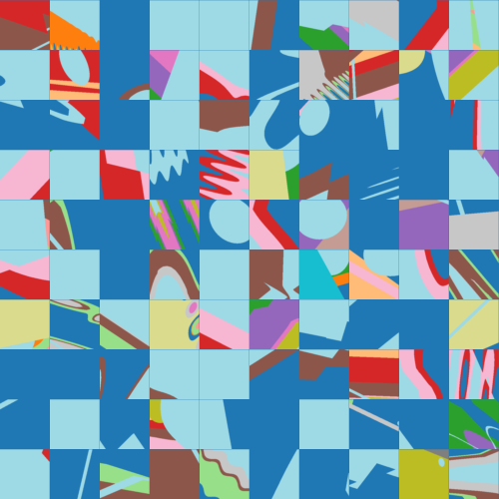
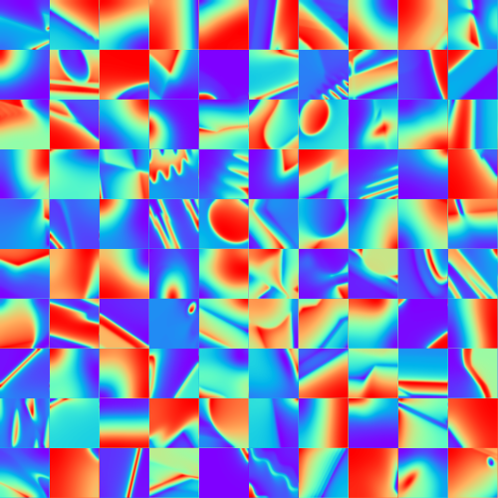
Example models
100 randomly generated models randomly selected from database
4kx4kx4k
20m voxels
grav
Top surface of model
mag

Slide 11
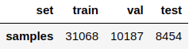
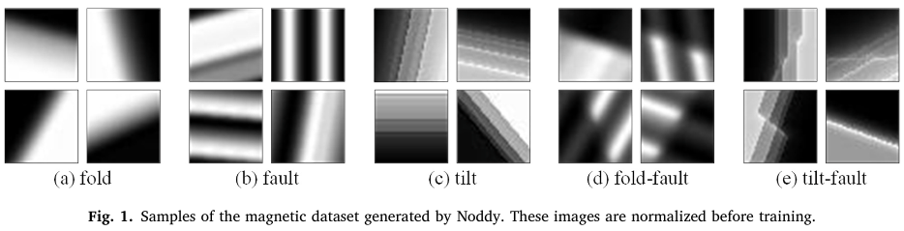
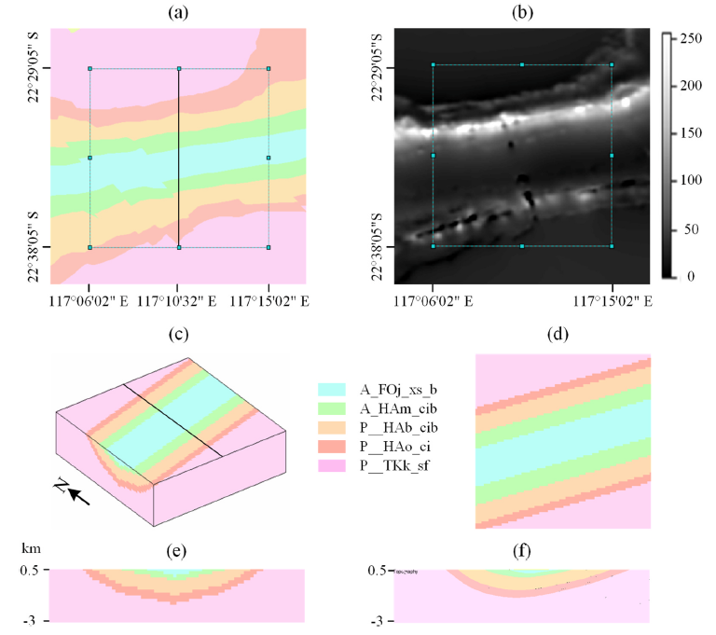
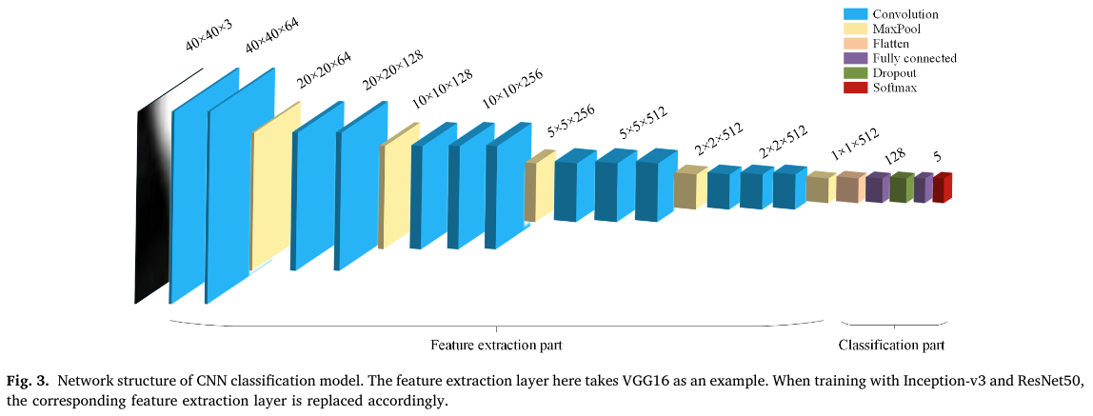
Goal: predict the parameters of the geological structure (eg, dip direction and the dip angle of the fold axial surface)
Magnetic field 2D images
Noddy dataset, ~50k samples
Classifier
Inception-v3
(very deep) CNN
~1 day training
3D geological structure inversion from Noddy-generated magnetic data using deep learning methods, Guo et al., Computers & Geosciences 2021, 104701

Slide 12
Can we generalise this method to more complex scenarios?
We can make a million models, we could even make a billion models, but we can’t make the trillions of models right now that would be needed to generalise this approach.
But if take a hierarchical approach using:
Feature extraction to reduce the dimensionality of each model
Expert elicitation: I know there are faults, unconformities and folds in may area, but not sure on the detail…
History estimation
We may be able to produce custom Noddyverses to understand specific locations

Slide 13
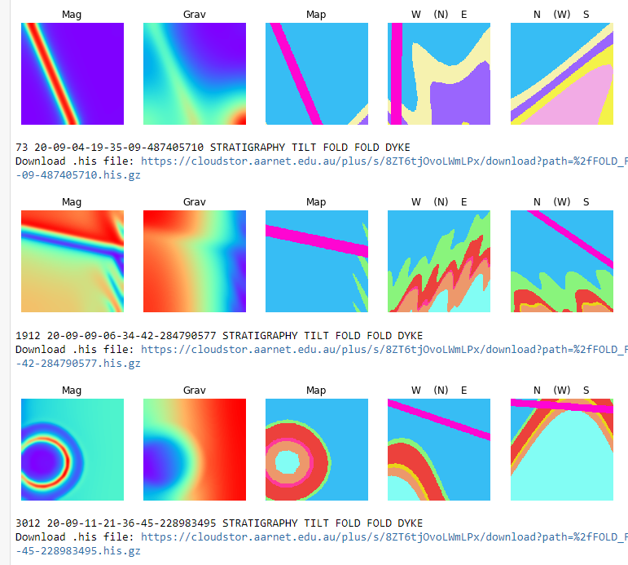
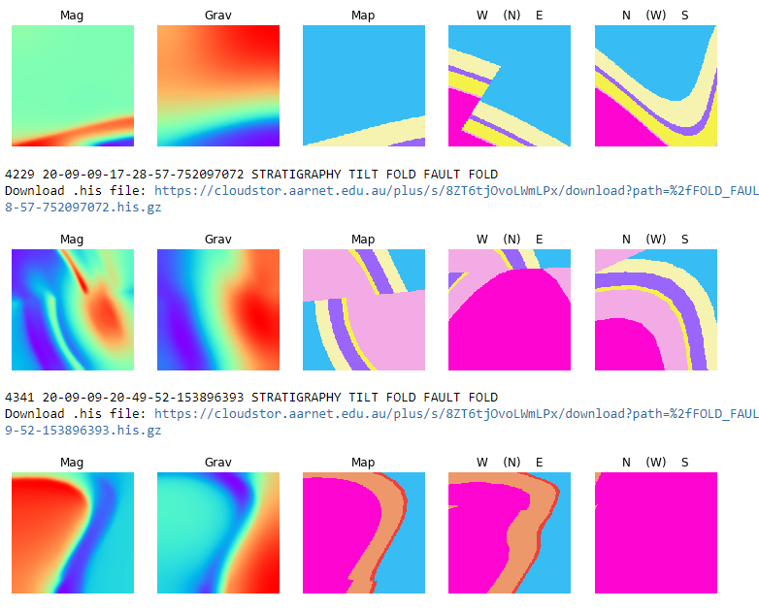
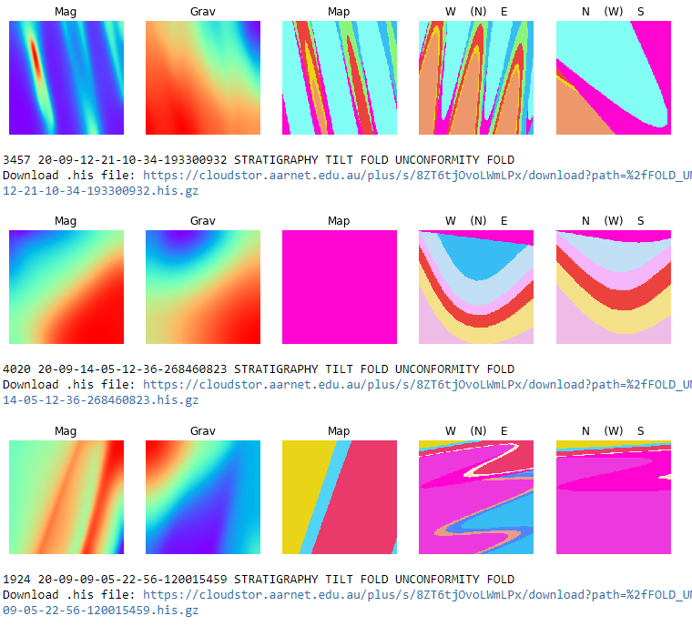


A new Challenge
Open Access 1M labelled model suite with more diverse geological histories including diverse stratigraphies available here:
github.com/Loop3D/noddyverse
sampling from 4036 models matching
['FOLD', ‘FOLD', ‘DYKE’]
event sequence
sampling from 7994 models matching
['FOLD', 'FAULT', 'FOLD’]
event sequence
sampling from 4094 models matching
['FOLD', 'UNCONFORMITY', 'FOLD’]
event sequence

Slide 14
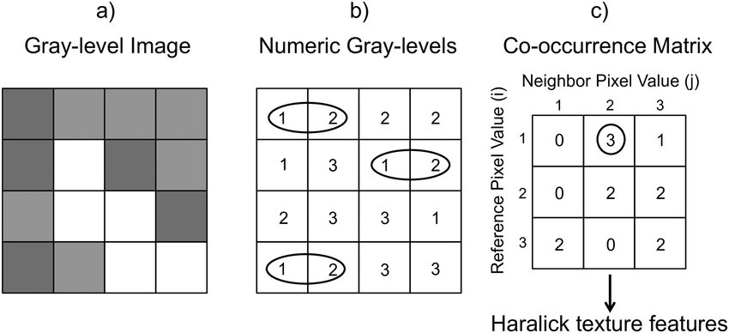
Haralick Feature Extraction
Could also explore other Feature Extraction approaches: Multi-scale Haralick Features, Hough Transforms, Harris Corner Detection …
R. M. Haralick, K. Shanmugam and I. Dinstein, "Textural Features for Image Classification," in IEEE Transactions on Systems, Man, and Cybernetics, vol. SMC-3, no. 6, pp. 610-621, Nov. 1973, doi: 10.1109/TSMC.1973.4309314.
10.1371/journal.pone.0211060

Slide 15
t-SNE (t-distributed stochastic neighbour embedding)
t-SNE a non-linear dimensionality reduction algorithm that finds patterns in the data based on the similarity of features in data points, which is calculated as the conditional probability that a point A would choose point B as its neighbour.
It then tries to minimize the difference between these conditional probabilities (or similarities) in higher-dimensional and lower-dimensional space for a perfect representation of data points in lower-dimensional space.
Could also explore other dimensionality reduction approaches: Principal Component Analysis, Non-negative matrix factorization, Generalized discriminant analysis, Uniform Manifold Approximation and Projection and Self-organizing maps …
Laurens van der Maaten & Geoffrey Hinton, Visualizing Data using t-SNE, Journal of Machine Learning Research 9 (2008) 2579-2605

Slide 16
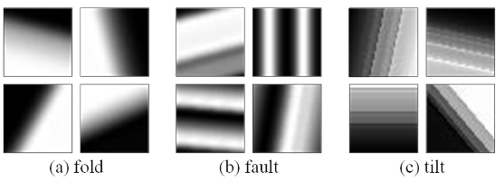
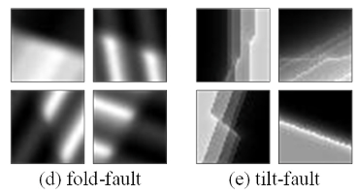
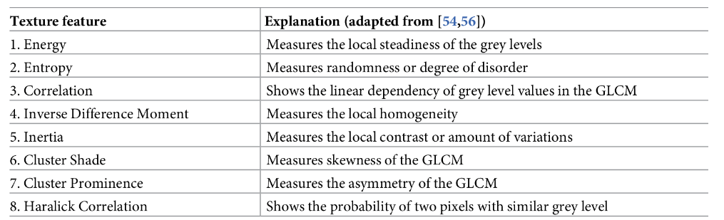
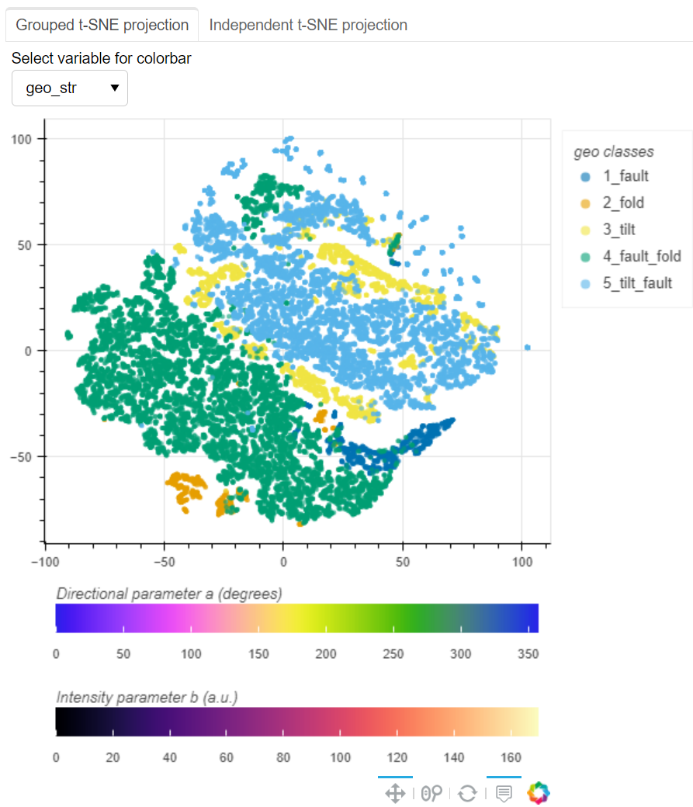
Estimation of structural evolution from synthetic geophysical images
Haralick Features used to describe the texture of the image, reducing 200x200 pixels to 13 features
t-SNE (t-distributed stochastic neighbour embedding) visualizes the resulting 13-dimensional dataset by giving each datapoint a location in a two-dimensional map
Noddy Models
13 Haralick features per model, based on Gray-Level Co-occurrence Matrix
2D mapping of Haralick Features
…
doi.org/10.1371/journal.pone.0234703
dx.doi.org/10.5334/jors.ac
~30 minutes
pypi.org/project/openTSNE/
Notes:
t-distributed stochastic neighbor embedding

Slide 17
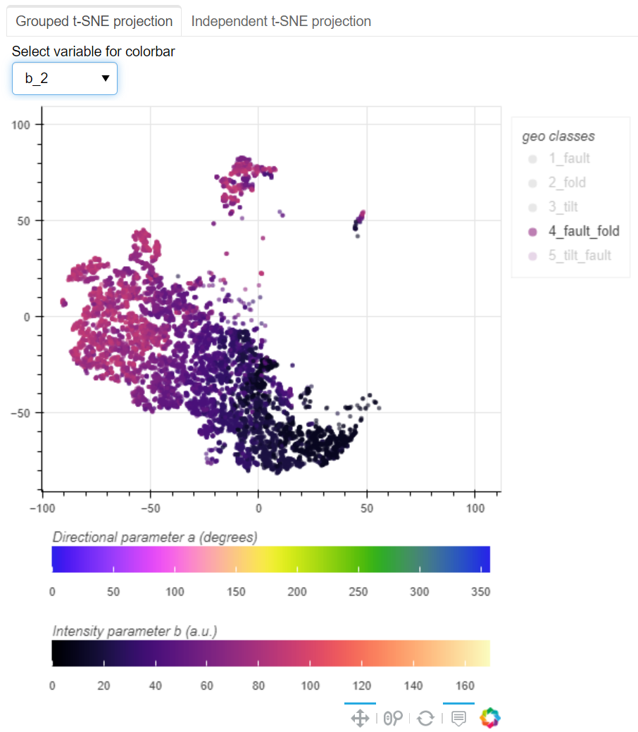
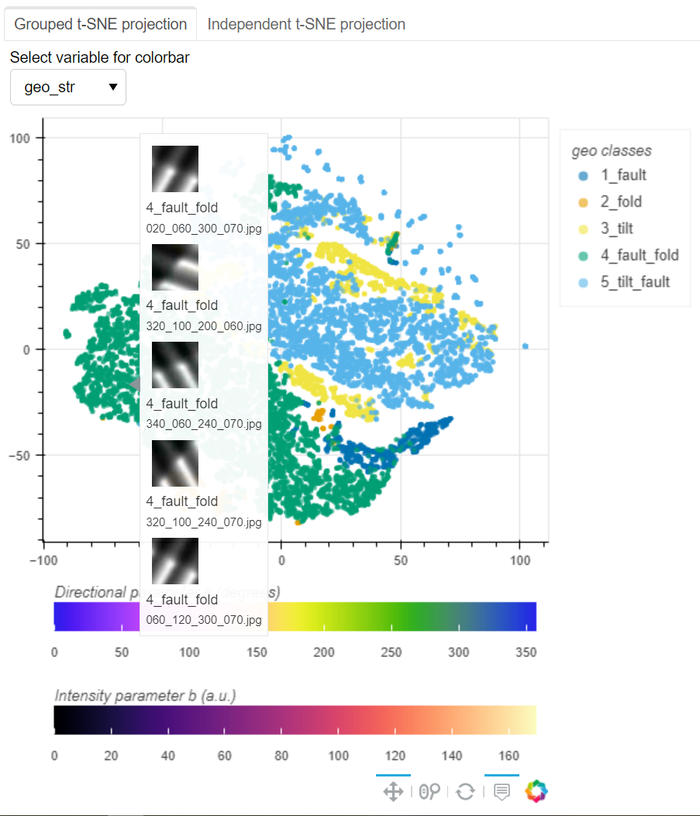
t-SNE plot of Haralick Features
1 or 2 events
42,000 models
5 classes
Haralick/T-SNE independently produces coherent domains that reflect prior labels
Specific structural parameters vary systematically within single domains
Fold axial plane dip

Slide 18
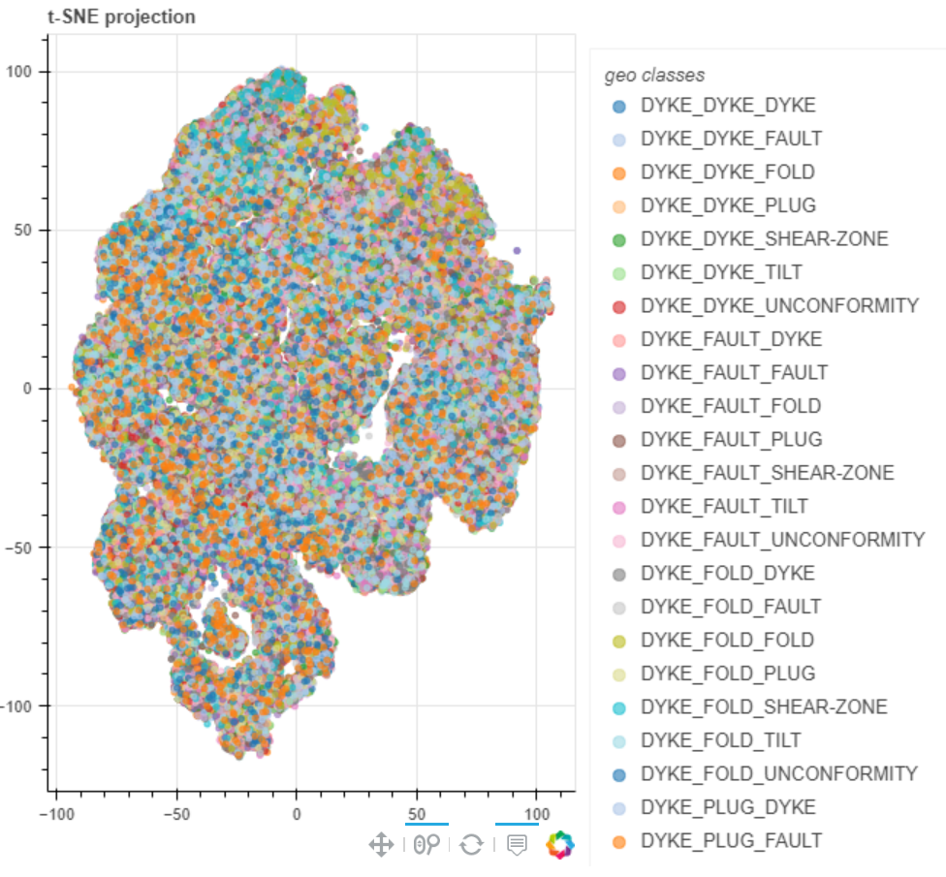
t-SNE plot of Haralick Features
3 events
300,000 models
343 classes
Another 320 orderings

Slide 19
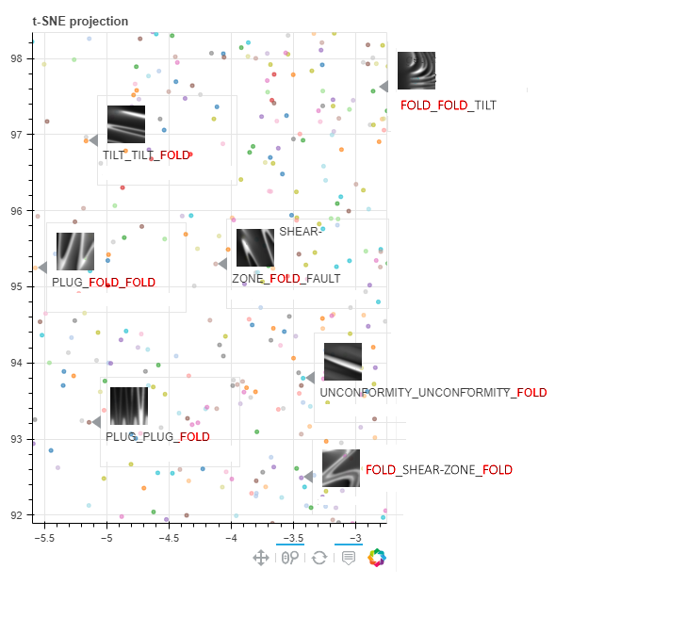
DIFFERENT geophysical images
COMMON structural event
TILT_TILT_FOLD
FOLD_DYKE_TILT
PLUG_FOLD_FOLD
SHEAR-ZONE_FOLD_FAULT
UNCONFORMITY_UNCONFORMITY_FOLD
PLUG_PLUG_FOLD
FOLD_SHEAR-ZONE_FOLD

Slide 20
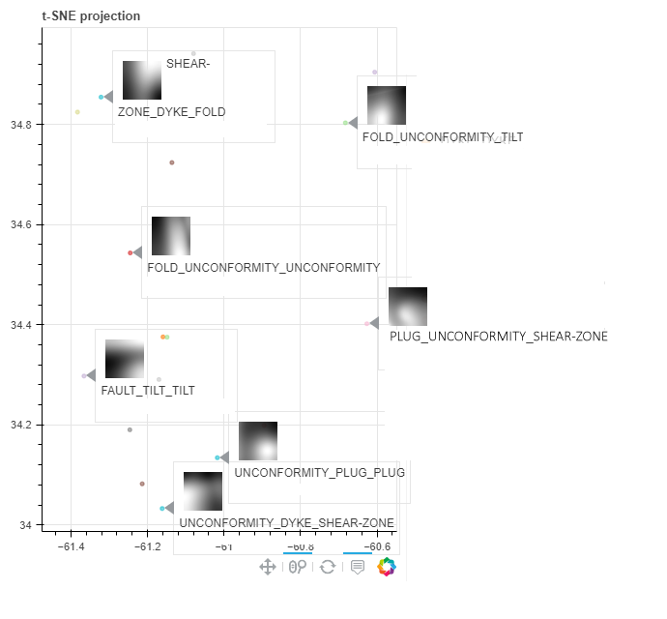
COMMON geophysical images
DIFFERENT structural events
SHEAR-ZONE_DYKE_FOLD
FOLD_UNCONFORMITY_TILT
FOLD_UNCONFORMITY_UNCONFORMITY
PLUG_UNCONFORMITY_SHEAR-ZONE
FAULT_TILT_TILT
UNCONFORMITY_PLUG_PLUG
UNCONFORMITY_DYKE_SHEAR-ZONE

Slide 21
Conclusions
Use of Machine Learning in the geosciences needs labelled datasets, but the Google user base is too busy looking at cats to help us
In this study we have shown the potential of non-physics-based 3D modelling to provide large arbitrarily complex time-aware 3D models and their potential-field response
In simple sub-sets of the model space CNN & Haralick/t-SNE methods appear to provide useful pathways to history and parameter inversion
For large more generalised model suites, interesting results support the continuation of this approach, and expert elicitation will undoubtably save us time in defining relevant model suites

